Slide 1
HTML
Hypertext Markup Language

Slide 2
Hyper text system
Tim Berners-Lee
1989

Slide 3
HTML2
1995

Slide 4
HTML 3
1997 jan 14

Slide 5
HTML 4
1997 dec 18
Deferent version
4.0
4.01

Slide 6
HTML 5
2014 5
2016 5.1
2017 5.2

Slide 7
HTML layout
<html>
<head>
<title> </title>
</head>
<body>
</body>
</html>

Slide 8
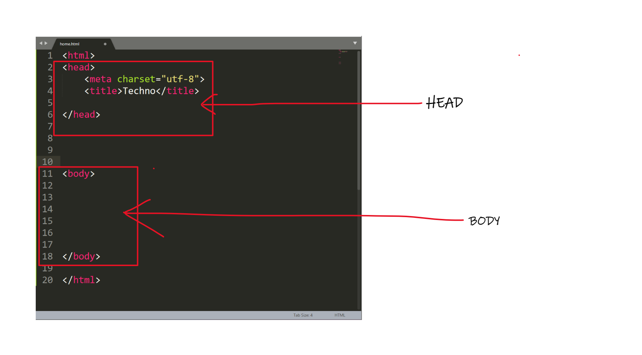

Slide 9
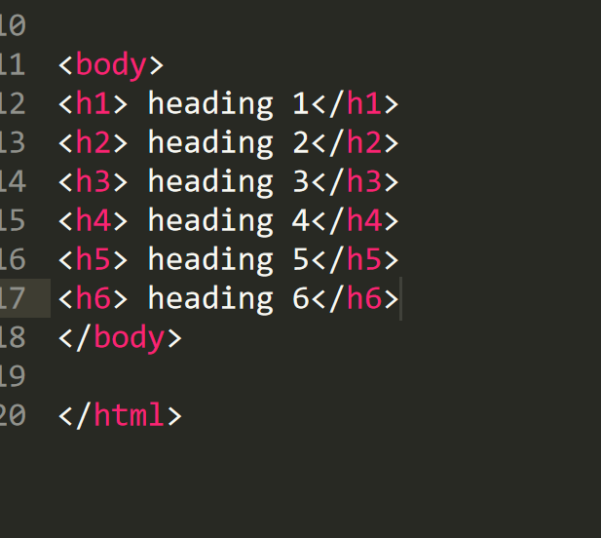
H1 to H6 Tag

Slide 10
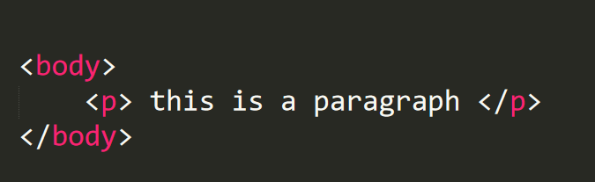
Paragraph Tag

Slide 11
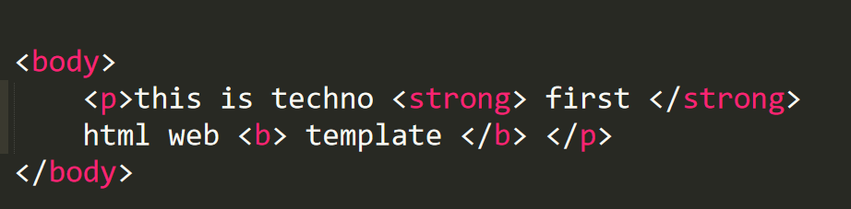
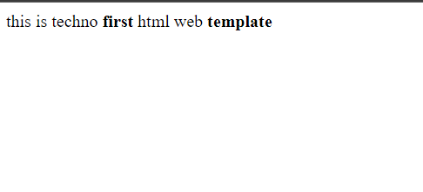
. <b> tag and <strong> tag

Slide 12
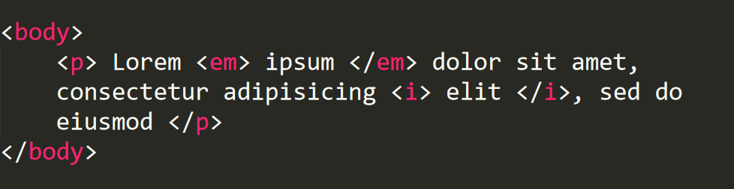
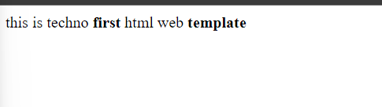
<i> tag and <em> tag

Slide 13
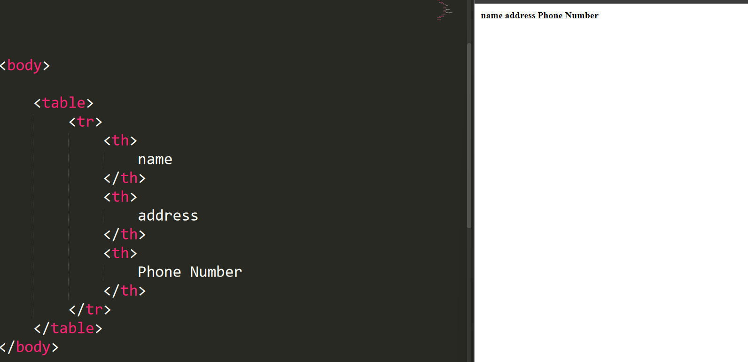
Table Tag

Slide 14
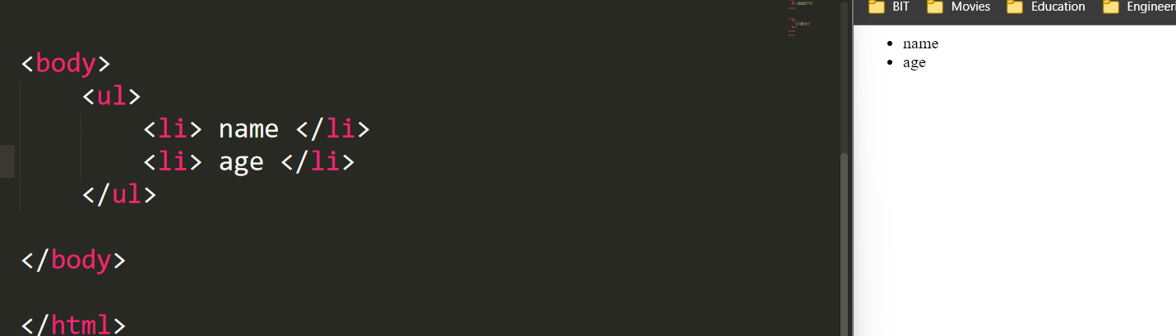
Ul tag

Slide 15
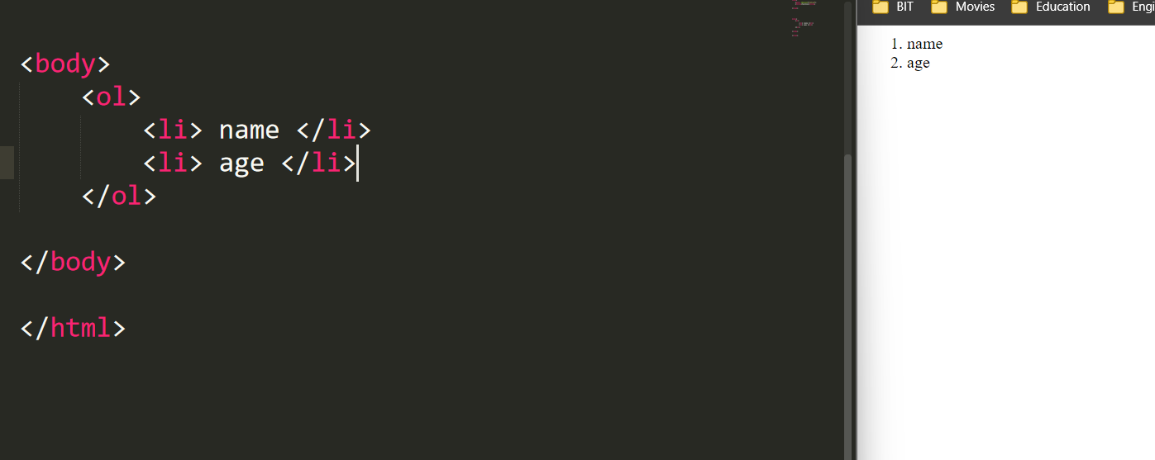
Ol tag

Slide 16
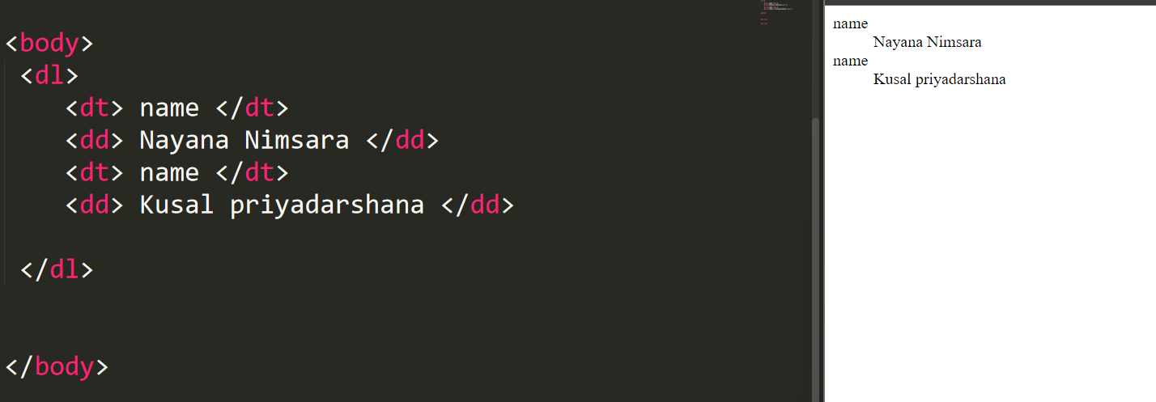
Dl(descriptive list)

Slide 17
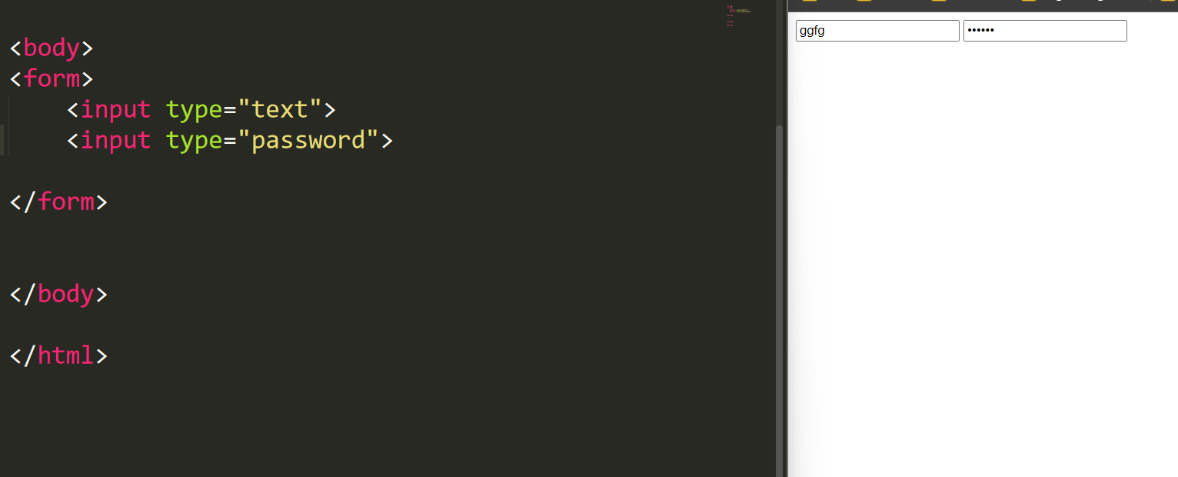
Form

Slide 18
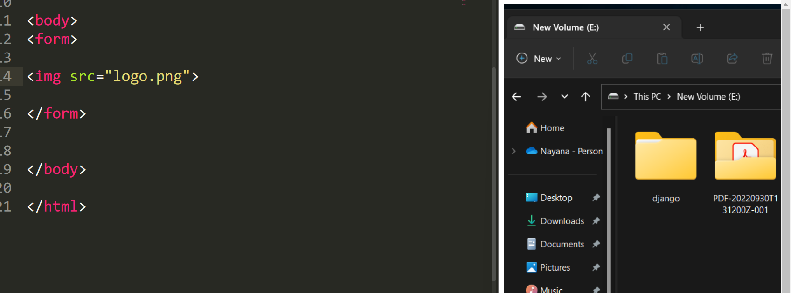
Img tag

